Slide 1

Pixelated
Press [Enter] to start

Slide 2

Pixelated
>
Play
Options
Exit

Slide 3

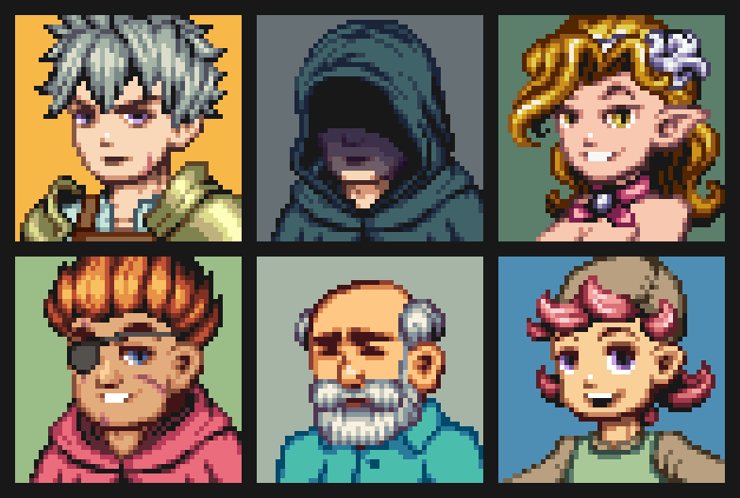
back
Pixelated
Choose your character
P1
P2
P2

Slide 4



back
Pixelated
Settings
Sound
Language
English

Slide 5

back
Pixelated
Choose your location
P1
P2

Slide 6



HP
HP
Energy
Energy

